Slide 1
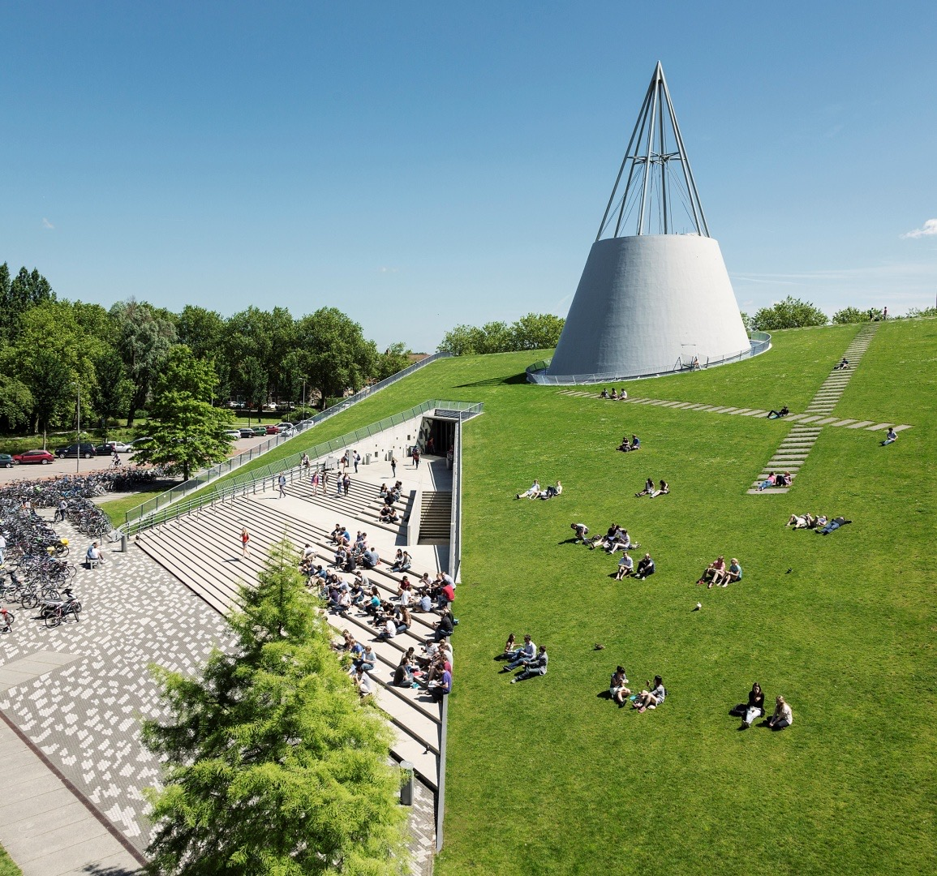
Indoor Localization with multi-rate Kalman filter
Yiting LI 5281873
January 13 2023
Notes:
Hi everyone, my name is Yiting LI, this is my midterm presentation about my thesis, the indoor localization with multi-rate kalman filter

Slide 2
Outlines
Research questions
Methodology
Result examples
Outlooks
Notes:
The presentation will be given from the 4 parts:

Slide 3
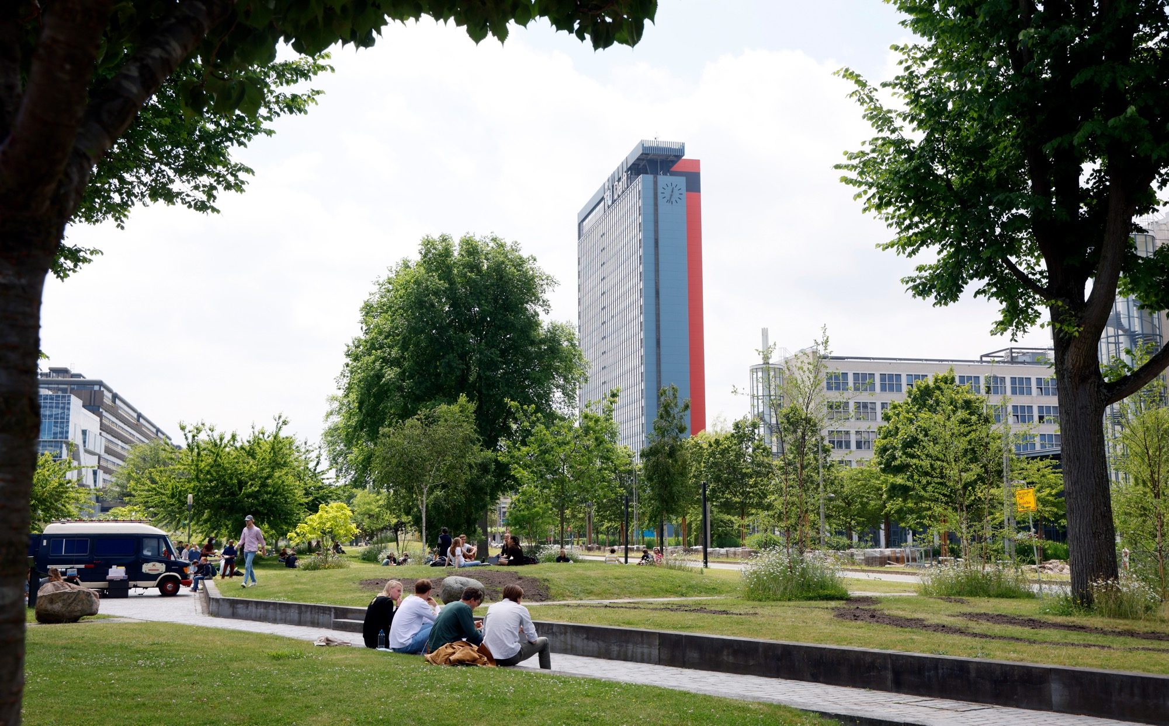
TU Delft
History
Impact for a better society
Organisation & figures

Slide 4
TU Delft – History

Slide 5
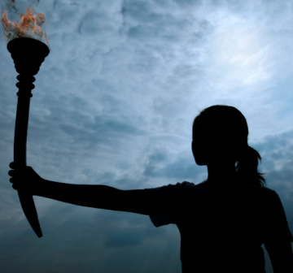
History
The fire of Prometheus
Notes:
The TU Delft logo features a flame above the "T" in "TU Delft". The flame and letter together form a burning torch. This is a reference to the fire of Prometheus, a figure from Greek myth who stole the fire from the gods and gave it to the people. Prometheus taught humanity how to use fire to work metal. As a result, he is known as the very first teacher of technology.

Slide 6
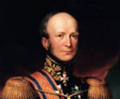
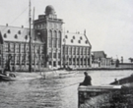
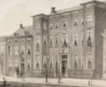
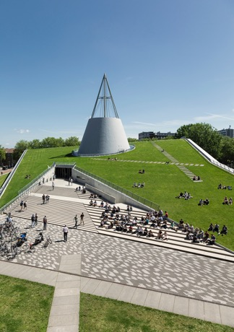
History
1842-1864:
Royal Academy
1905-1986:
Delft Institute of Technology
1842-1864
1864-1905
1905-1986
1986-now
1864-1905:
Polytechnic School
1986-now:
TU Delft
Notes:
1842-1864: Royal Academy On 8 January 1842, King William II established the 'Royal Academy for the education of civilian engineers, for serving both nation and industry, and of apprentices for trade'. The Academy also trained civil servants for the colonies and tax officials for the Dutch East Indies.
1864-1905: Polytechnic School On 2 May 1863, a law was enacted establishing the rules for technical education, bringing it under the influence of the rules that applied for secondary education. Later, on 20 June 1864, the Delft Royal Academy was disbanded by Royal Decree in order to make way for a new ‘Polytechnic School’. It began training architects and engineers in civil engineering, shipbuilding, mechanical engineering and mining.
1905-1986: Delft Institute of Technology On 22 May 1905, a law was enacted that recognised the academic level of the technical education offered by the Polytechnic School and it became a Technical College, or Institute for Technology. Queen Wilhelmina attended the official opening on 10 July 1905. The Institute’s first Rector Magnificus was the professor of hydraulic engineering, ir. J. Kraus.
1986-present: Delft University of Technology In accordance with a law enacted on 1 September 1986, the Institute officially became Delft University of Technology, abbreviated to TU Delft.

Slide 7
TU Delft – Impact for a better society

Slide 8
Impact for a better society
At TU Delft, we aim to make an ‘impact for a better society’. We take on global challenges that affect everyone personally: the climate, the energy transition, urban growth, digital society, health. We do all of this the Delft way – thoroughly, hands on, pragmatically, innovatively, with guts, outside the box and socially engaged. We always work on the basis of multiple perspectives and interests. Our solutions are future-proof. We do not work alone, but together with our partners. Inspired by ambition, TU Delft works to achieve positive change through world-class research, teaching and innovation, whether it is sustainable aviation, clean water or the future of the internet.
Notes:
Strategy https://www.tudelft.nl/en/about-tu-delft/strategy

Slide 9
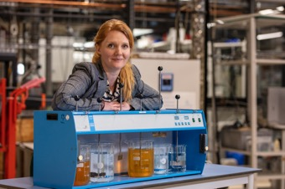
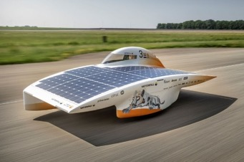
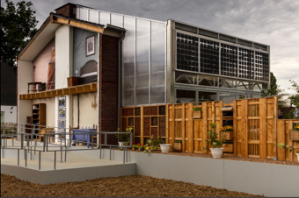

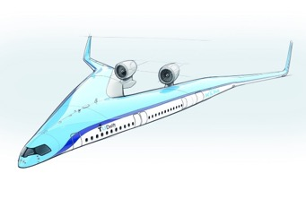
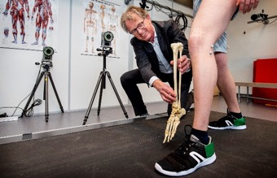
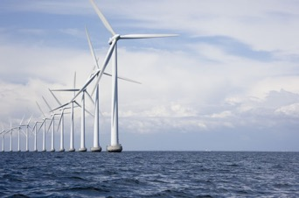
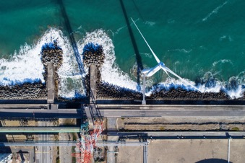
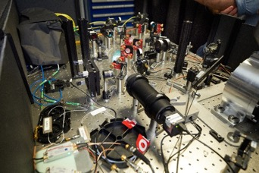
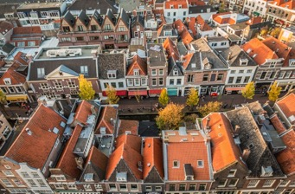
Impact for a better society: 5 social themes
Health & Care
Energy Transition
Climate Action
AI & Digital Society
Urbanisation & Mobility

Slide 10
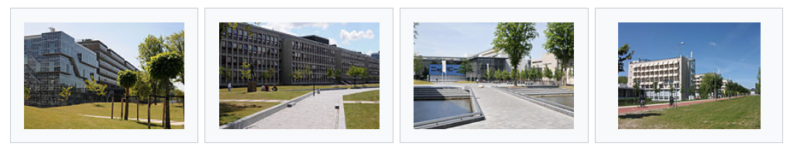
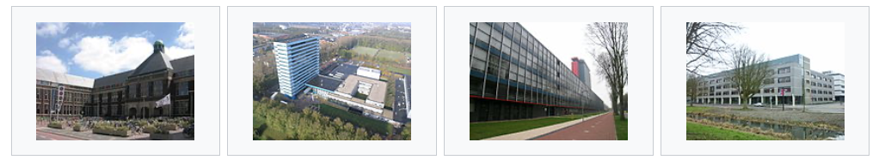
8 faculties: 16 BSc, 33 MSc and post-graduate programs
CEG
Civil Engineering and Geosciences
AS
Applied Sciences
IDE
Industrial Design Engineering
3mE
Mechanical, Maritime and Materials Engineering
BK
Architecture and the Built Environment
AE
Aerospace Engineering
EEMCS
Electrical Engineering Mathematics & Computer Science
TPM
Technology, Policy and Management

Slide 11
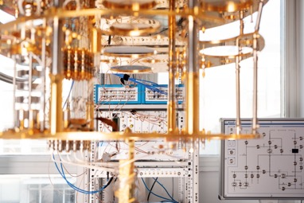
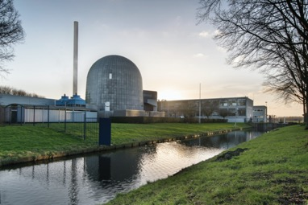
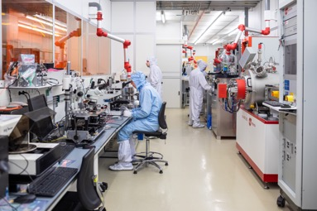
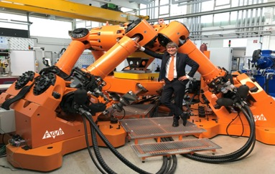
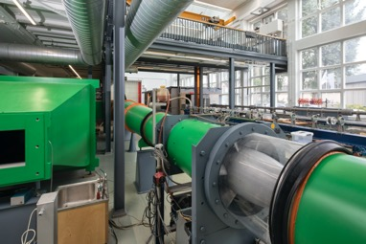
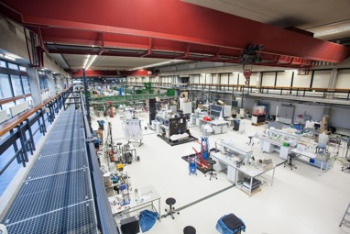
A wide range of research facilities, including:
QuTech
Reactor Institute
Labs
Hexapod
Wind tunnel
WaterLab

Slide 12






























Broad cooperation
REGIONAL
NATIONAL & INTERNATIONAL
PARTNERS
TU DELFT CAMPUS &
DELFT
Delft
Schieoevers
Biotech Campus
Delftechpark

Slide 13
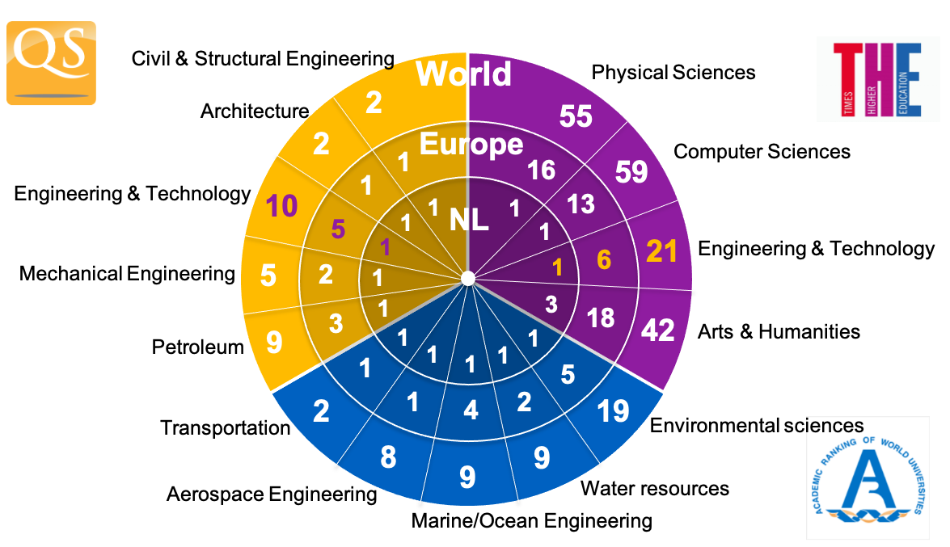
Strong international position
Notes:
For the most recent insights: https://www.tudelft.nl/en/about-tu-delft/facts-and-figures/tu-delft-in-international-rankings

Slide 14
TU Delft – Organisation and Figures

Slide 15
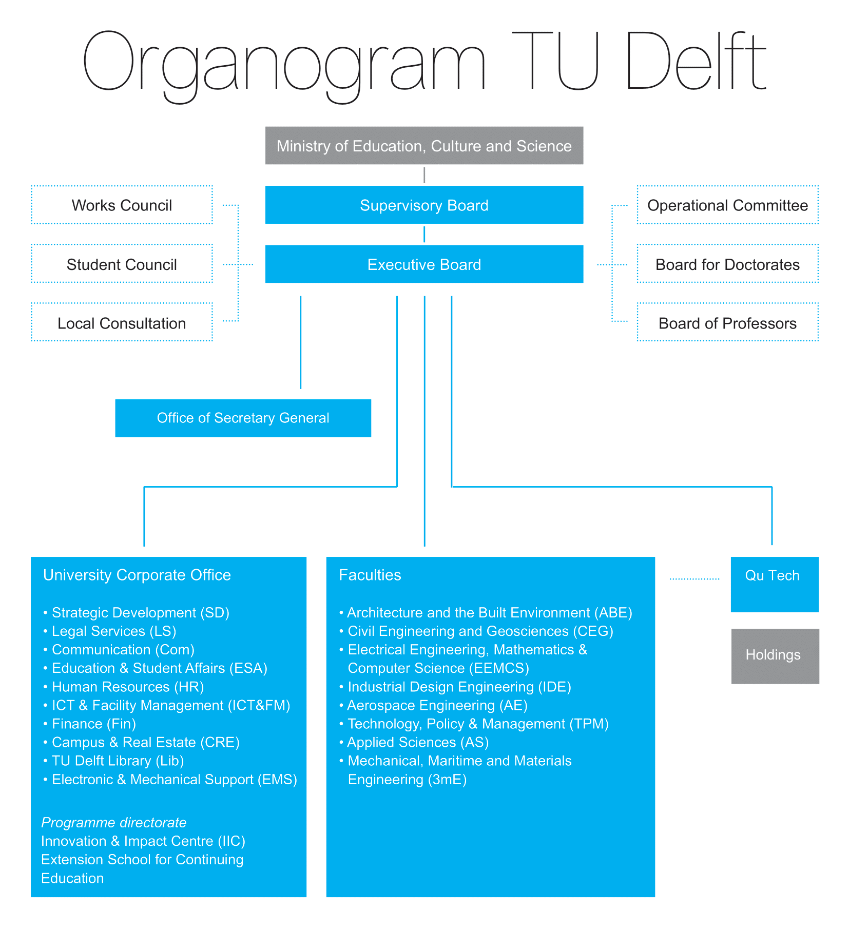
TU Delft Organisation
Notes:
Organogram: https://www.tudelft.nl/en/about-tu-delft/organisation

Slide 16
Figures
Students | Dec-21 PhD population | 2021
27,270
3,001
BSc/MSc degrees | 2020/21 PhD defences | 2021
6,815
431
Staff | Dec-21 Publications | 2021
6,347
7,059
Notes:
Recent figures: https://www.tudelft.nl/en/about-tu-delft/facts-and-figures

Slide 17

Online education for lifelong learning
3.5 Million registered users
and counting
Hundreds of courses and short programs
Learner-centred and highly applicable
Broadening the skillset and supporting career paths
https://www.tudelft.nl/extensionschool
Notes:
Since 2013, the Extension School for Continuing Education is the entity responsible for realizing our university’s contribution to life long learning and post-higher education training and development. The recipient of several prestigious awards as leader in online education, it works with TU Delft faculties and external partners to develop and deliver online courses and programs to equip people to solve today’s global challenges.
The key focus is delivering expert knowledge and applicable skills for lifelong learners and working professionals. By combining TU Delft’s academic knowledge with advanced learning methods and tools, our online courses and short programs help learners at various stages of their professional life – to stay on top of their game – whether they are looking to change career, broaden their skillset, or acquire further academic qualifications.
https://www.tudelft.nl/extensionschool

Slide 18
Alumni
Countries
Netherlands Germany United Kingdom Belgium Spain Italy China France Switzerland | 95.530 2.851 2.294 1.949 1.774 1.577 1.567 1.268 1.261
Top 10 companies
ASML Shell TNO Royal Haskoning DHV Philips ING Rabobank Deloitte McKinsey Airbus | 1.083 1.046 772 716 495 266 245 236 170 169
Notes:
Source: LinkedIn Sep-21

Slide 19
Thank you for your attention
#betterTUgether

